Slide 1
WheelTalks

Slide 2
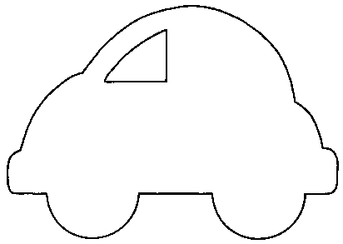
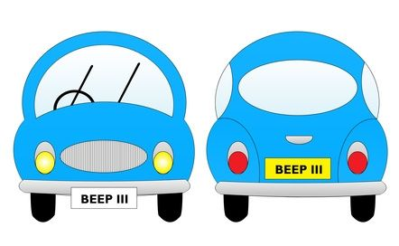
WheelTalks
WheelTalks
Sam & Marc
WheelTalks

Slide 3
WheelTalks
WheelTalks
WheelTalks

Slide 4
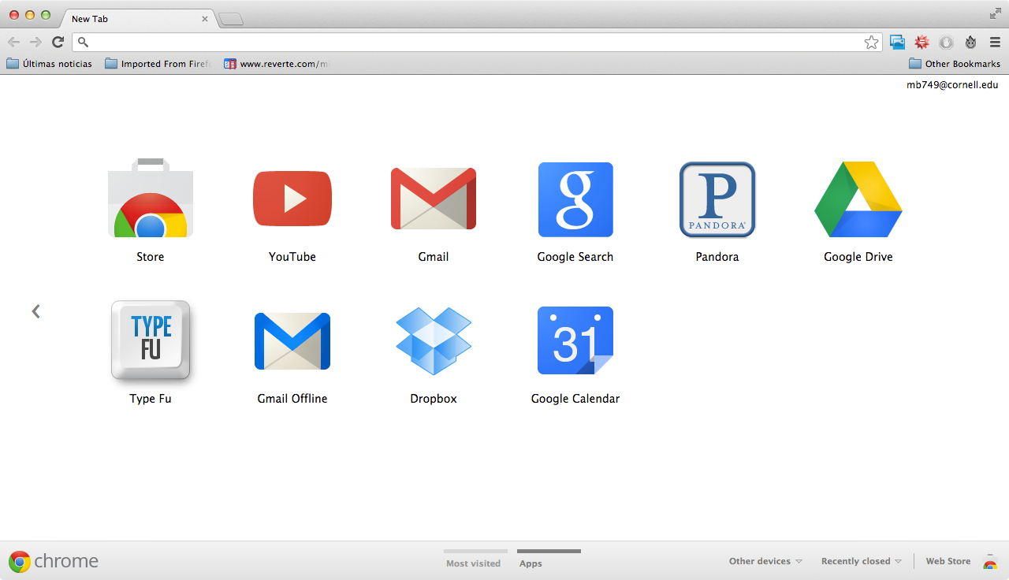
About
Mission
Team
Welcome to WheelTalks
Communicate with car owners while ensuring the privacy of both messengers and car owners
New to WheelTalks? Sing Up
Cell phone number
Car license plate
Sign up
WheelTalks

Slide 5
Welcome to WheelTalks
WheelTalks
WheelTalks
New to WheelTalks? Sing Up
Cell phone number
Car license plate
Sign up

Slide 6

About
Mission
Team
Connecting drivers
Welcome to WheelTalks
New to WheelTalks? Sing Up
Cell phone number
Text
Car license plate
Sign up

Slide 7
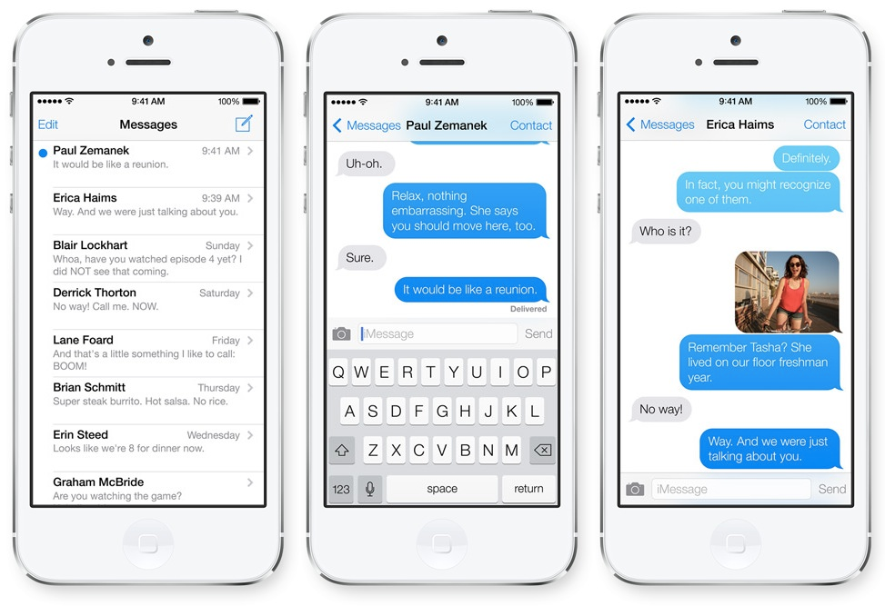
About
Mission
Team
Product
Wheeltalks is a new way to communicate with cars.
It's inspired by that time the car in front of us had a flat tire. We honked and yelled and tried to get next to the car but nothing we did got them to notice.
That time someone blocked us in at a function and we really needed to leave but all we could do was wait and get more and more angry.
That time the car alarm would not stopping beeping and the owner was no where to be found.
That time we were in a tow zone and didn't know it and before we knew it it was three hours, two hundred dollars later in the middle of no where picking up our car.
All those times brings us Wheeltalks.
We hope it will allow people to help each other. We hope that in time, with the ability to communicate with the cars around us in another way besides honking, we can increase the pleasure and attitude of driving on the road.
Now you can, and maybe they won't do it again. You can do much more! be creative! What else will you use it for? And there will be no exchange of contact information, you dont even have to give us your name!
WheelTalks
7jk656 - I am contacting you because you are about to get towed!

Slide 8
About
Mission
Team
How it works...
1) You enter your email, phone number, and license plate.
2) You get a text message from Wheelie to confirm your account.
3) You text Wheelie the license plate you wish to wheeltalk followed by a message.
4) Wheelie receives that message and wheeltalks it to the driver.
It's that simple!
WheelTalks
I am contacting you because you are about to get towed!

Slide 9
Text
WheelTalks
7jk656 - I am contacting you because you are about to get towed!

